Slide 1
Guideline,
AutoCAD Layer Standard
for Ascenx Drawing Template
Presents to DSE Division
06/10/2010
CONFIDENTIAL

Slide 2
Index
Layers standard and Drawing format style.
  Layer standard
  Format style of drawing
Template user guide
  Using Template
  Update information for BOM, REV Table
  Using Block library

Slide 3
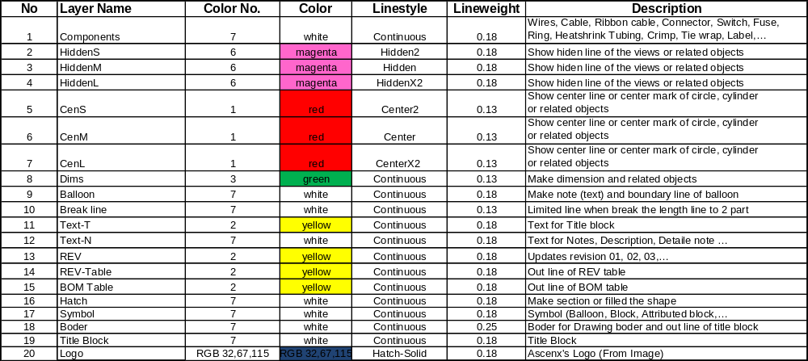
Ascenx's DSE Layer Standard
Note: Must use layers which were created for all Ascenx’s drawing

Slide 4
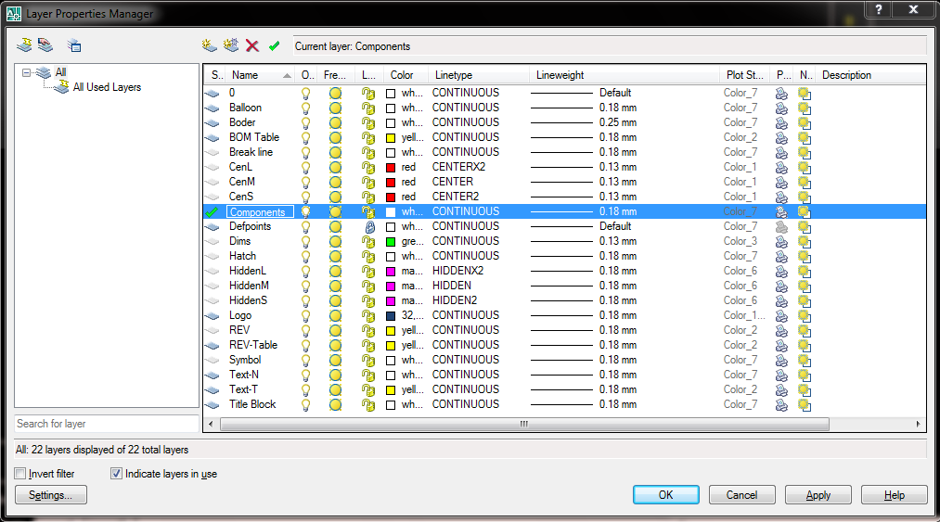
Layer Standard in AutoCAD

Slide 5
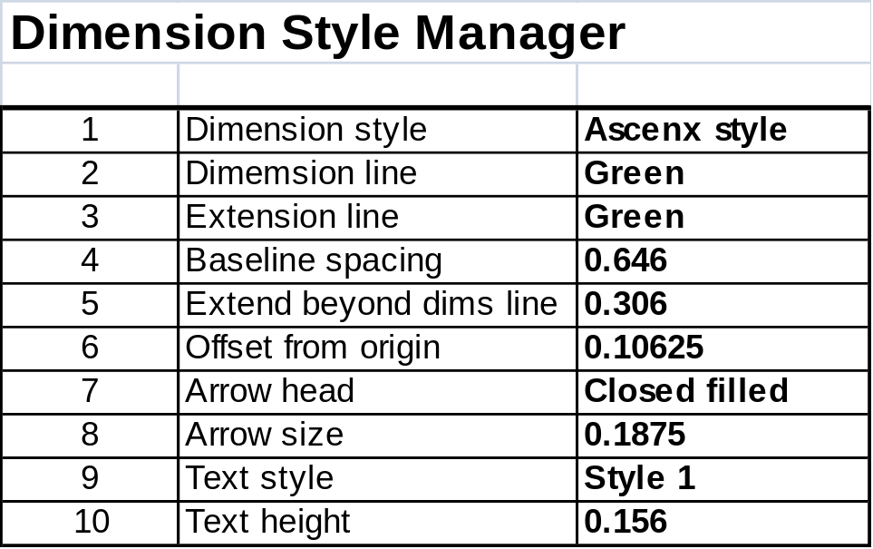
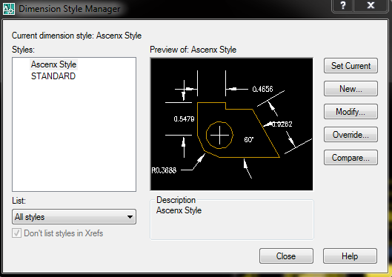
Format styles of Drawing
Note: Do not change parameter while they are not approve yet.

Slide 6
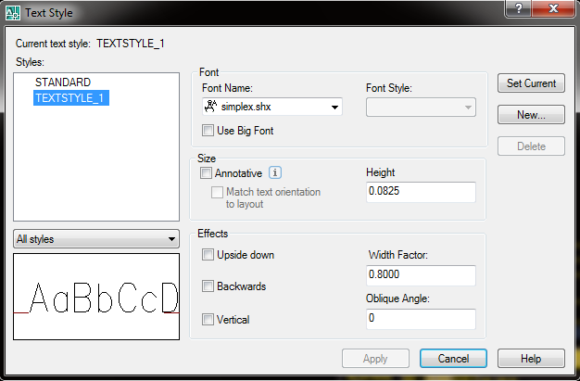
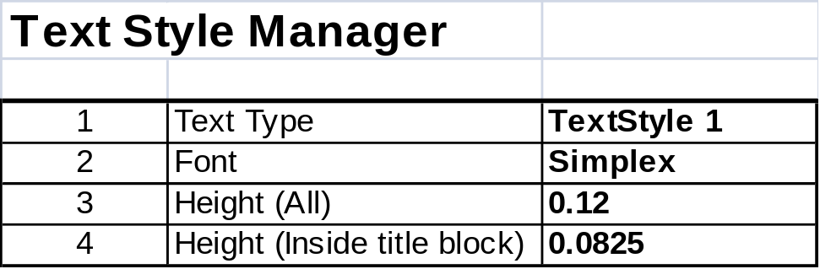
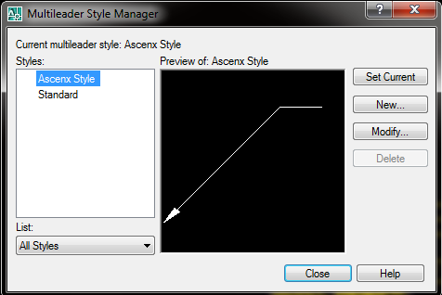
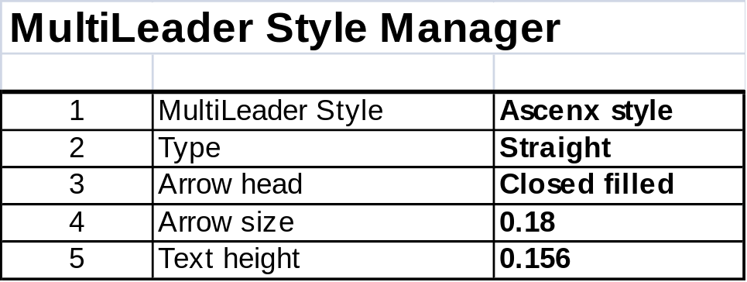
Format styles of Drawing (cont. 1)

Slide 7
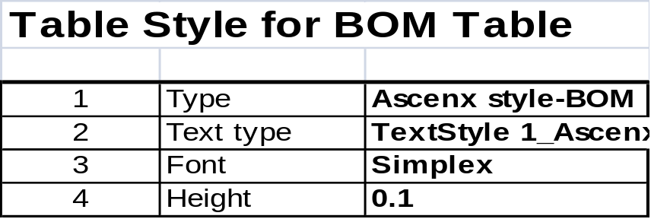
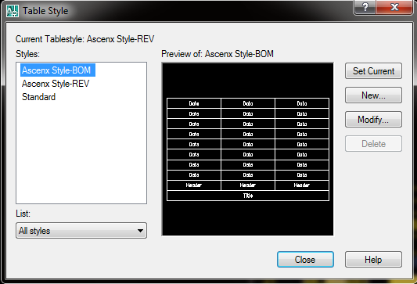
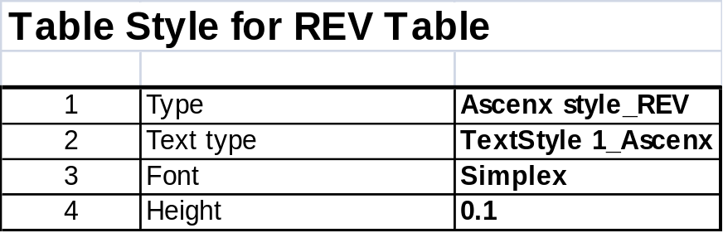
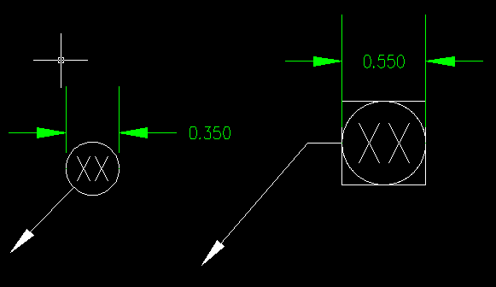
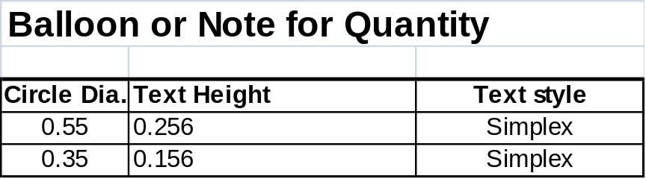
Format styles of Drawing (cont. 2)

Slide 8
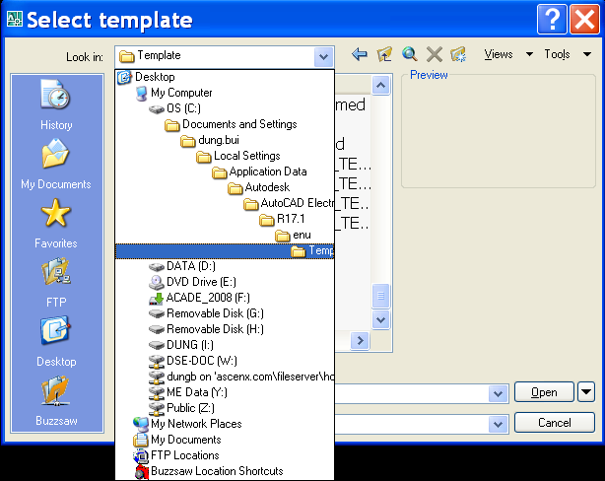
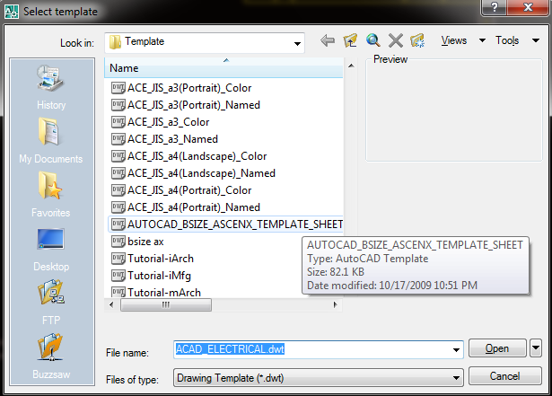
Using Template
Copy file TEMPLATE, AUTOCAD DRAWING, ASCENX (B/D SIZE, SHEET_01/02.dwt) to folder AutoCAD as below:
Using these template when create 1 new drawing (Command: New) by choose Ascenx template

Slide 9
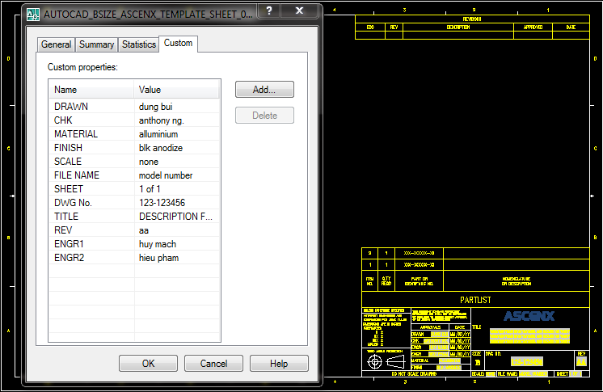
Update information for Title Block
Go to menu FILE\Drawing Properties  to update all information for title block such as DWG No., Drawn, Date,…
Push “Save” button to refresh & update info. In Title block
Note: May use function to create other parameters for drawing

Slide 10
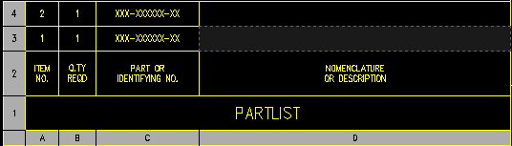
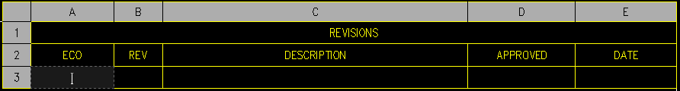
Update information for BOM & REV
All in information input to BOM or REV Table same with using Excel.

Slide 11
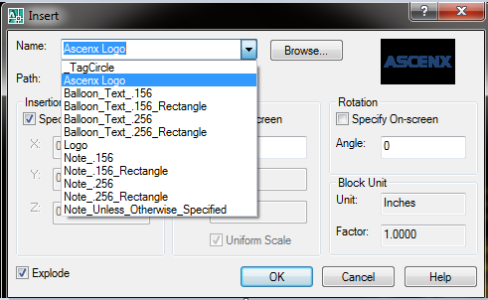
Using Ascenx attribute block library
Shortcut command : I
Note: Need update more block for drawing such as Connector, Terminal ring, Power supply,…

Slide 12
Using Plot for Ascenx style
Parameter for printing:
  Plot style table (pen assignment): monochrome.ctb
  What to plot: Display - Window
  Plot scale: fit to paper
  Check  Center the plot
  Check Plot  with styles (include Plot object with lineweights.
How to setup a Ascenx Ploter/Printer (PDF file is same)
  Chose plotter/printer -> properties
  Choose Device and Document Setting tab -> Custom properties
  Choose Paper/Quality tab -> Choose paper size and direction of paper -> OK
  Save as printer with name “Ascenx Printer 5200” or others → OK.
  Choose Save changes to the following file → OKSave as printer with named “Ascenx Printer 5200” → OK.
  Choose Apply to Layout
  If using pdfFactory Pro, pls set Metrics (Left, Top, Right, Bottom is 0.1”)

Slide 13
THANK YOU
ASCENX Technologies
1905 Tarob Court
Milpitas, CA 95035
Tel. 408-945-1997
Email. sales@ascenx.com
ASCENX Technologies Vietnam
e.Town 2 bldg., suite 608
364 Cong Hoa Street, Ward 13
Tan Binh District, HCMC, Vietnam
Tel. +84-8.297.1075
CONFIDENTIAL

Slide 14
BACKUP
CONFIDENTIAL

